Slide 1
Community Development Block Grant &
Emergency Solutions Grant
Application Workshop
2025-2026

Slide 2
HUD Funding Sources
Horry County is requesting applications for projects serving unincorporated Horry County for: CDBG & ESG
2025-2026 funding allocations have not yet been announced by HUD
2025 funding allocations should
be comparable to 2024
2024 Horry County allocations:
  CDBG – $1,912,865
  ESG – $171,970
Notes:
$7,966,529

Slide 3
Community Development
Block Grant
U.S. Department of Housing and Urban Development (HUD) provides annual Community Development Block Grant (CDBG) funding to Horry County.
Authorized under Title I of the Housing and Community Development Act of 1974.
Codified at 24 CFR 570

Slide 4
Horry County Urban Entitlement
Created in 2008, entitlement area consists of Horry County and the City of Myrtle Beach.
As part of a joint agreement, a portion of the funding is passed through Horry County to the City of Myrtle Beach for its CDBG programs.

Slide 5
Eligible Activities: Public Services
-Project Must be a New or Expanded Public Service
-Project must primarily serve unincorporated Horry County
-Project must meet a CDBG National Objective
-benefit low to moderate income persons (<80% AMI)
-Project must not subsidize normal operations
-Examples of Public Services include:
  Job Training
  Crime Prevention
  Child Care and After-School Programs
  Services for the Homeless
  Services for the Disabled
Source: U.S. Department of Housing and Urban Development www.hud.gov

Slide 6

CDBG National Objectives
Low/Mod Income
Slum/Blight
Urgent Need*
Area Benefit
Limited Clientele
Housing
Jobs
Area Basis
Spot Basis
Urban Renewal
*Horry County CDBG reserves this area of funding for county use only as it is only eligible for use in rare situations.

Slide 7
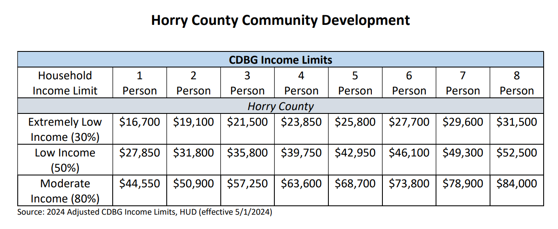
CDBG Income Limits

Slide 8
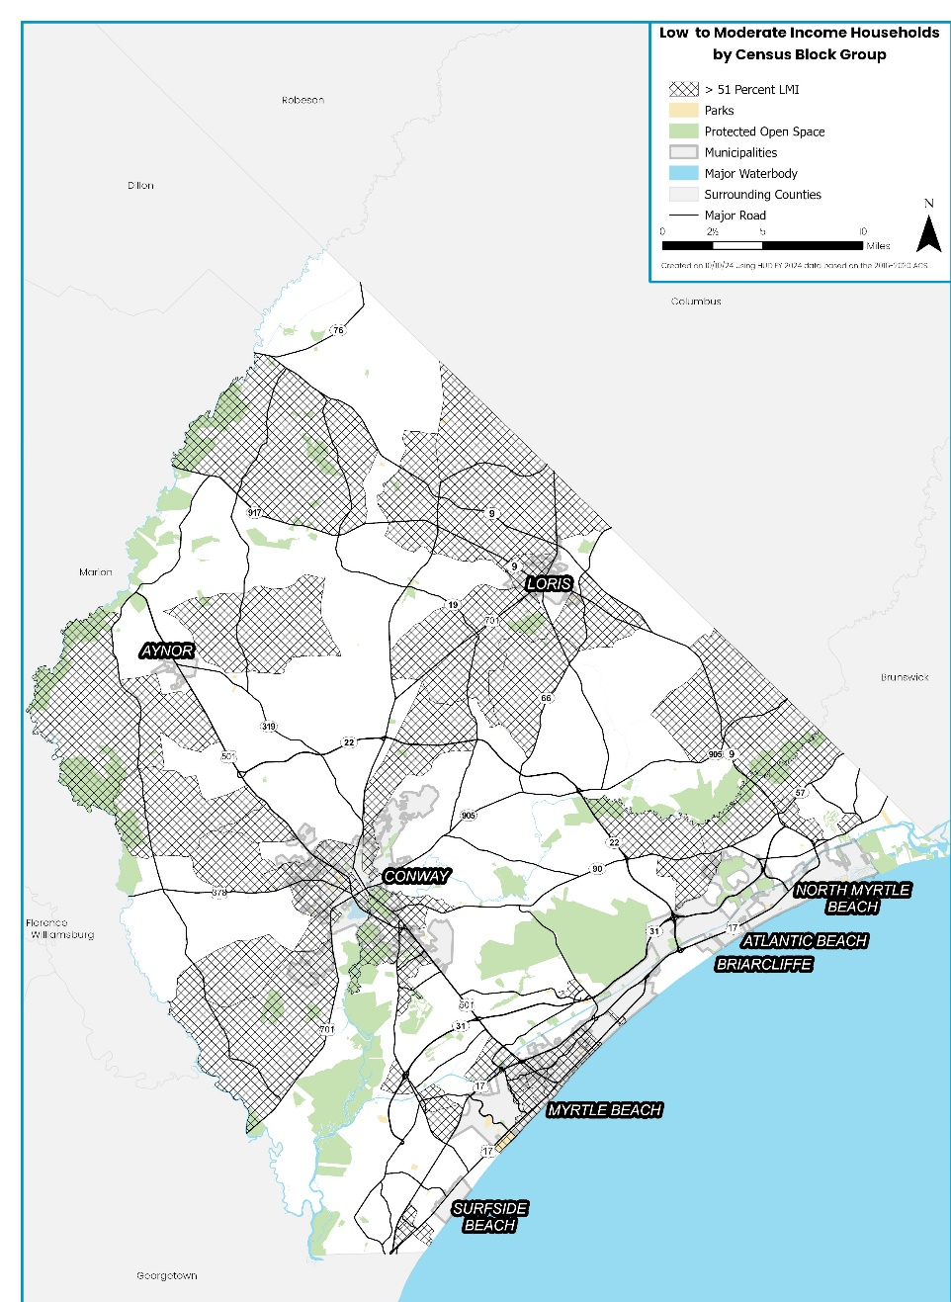
LMI Areas by Census Block Group

Slide 9
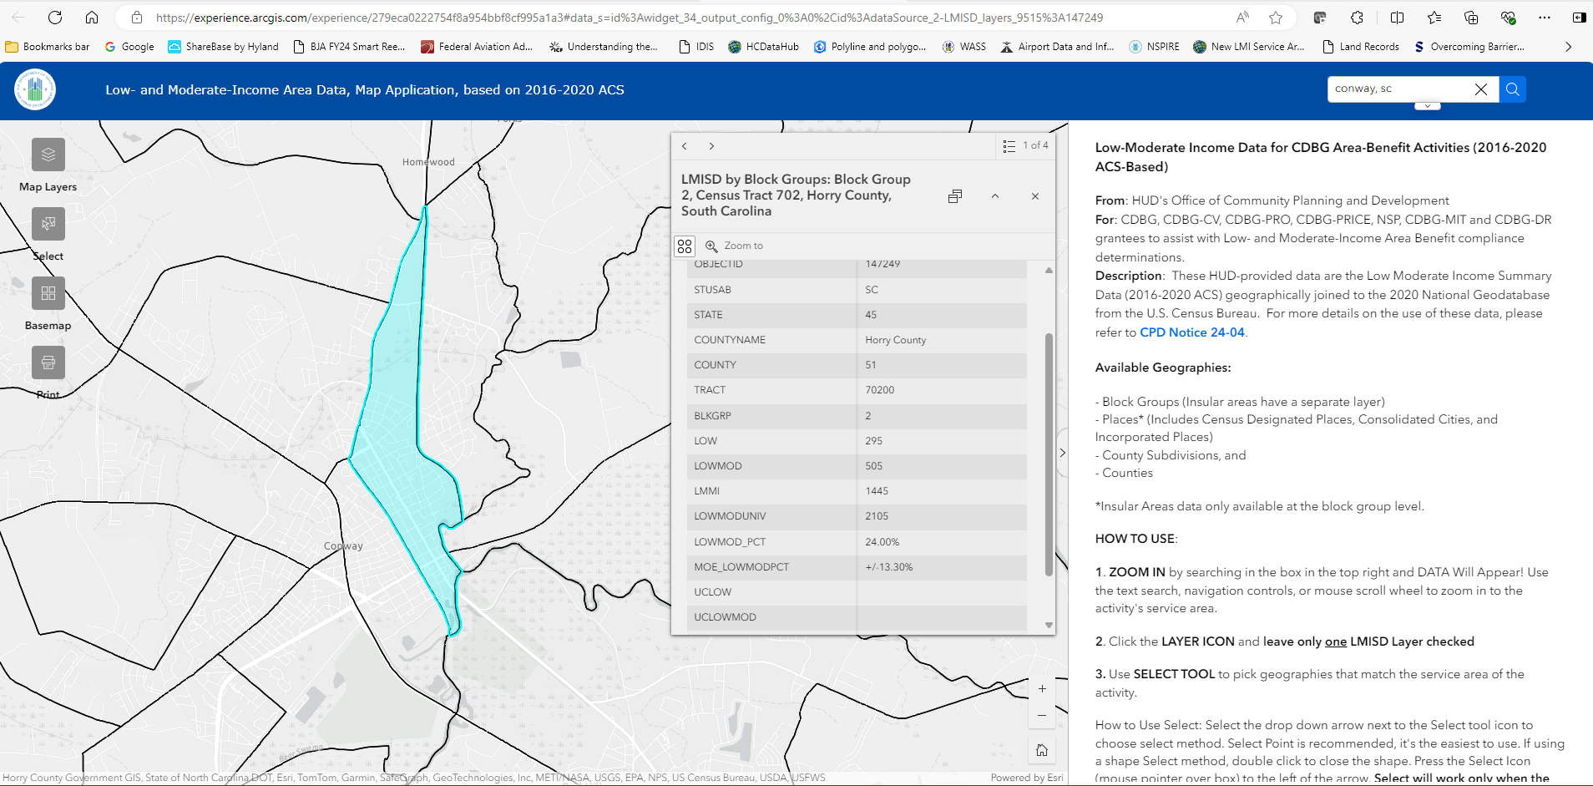
HUD LMI Mapping Tool
https://experience.arcgis.com/experience/279eca0222754f8a954bbf8cf995a1a3

Slide 10
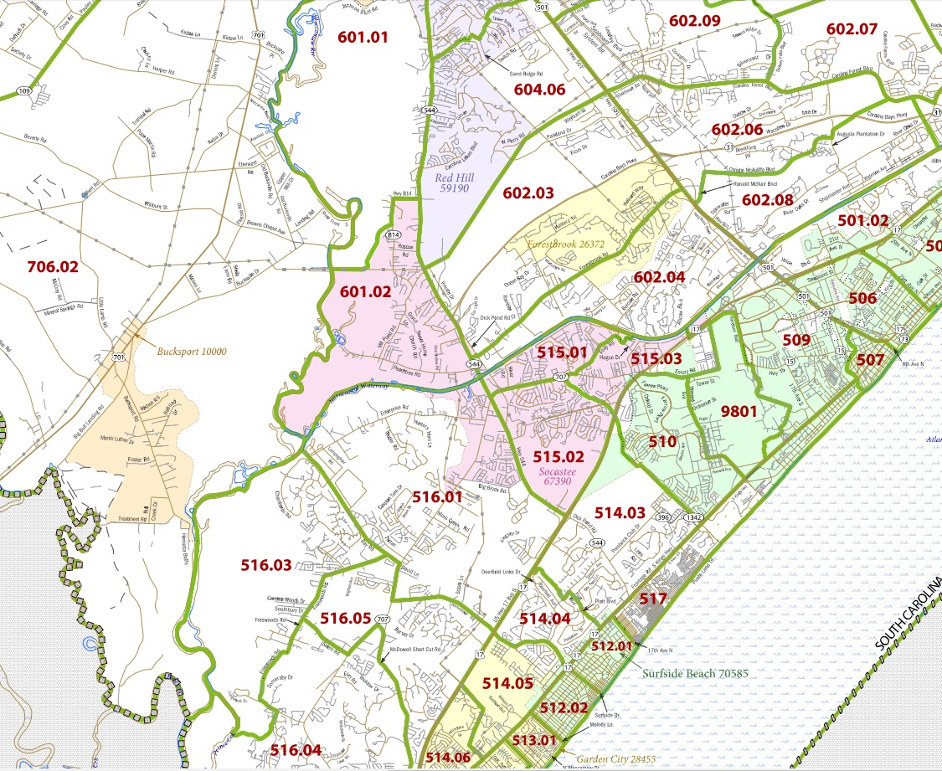
Target Areas: Racepath & Socastee
Racepath
Socastee

Slide 11
Funding Limitations
Benefit LMI Persons or Areas
  At least 70% of total grant
Public Services
  Capped at 15% of the total grant
Administration funds
  Capped at 20% of the total grant
Rate of Expenditure Monitored by HUD
  Subrecipients must have capacity
  Reimbursed after documentation of payment
  Annual grant – we will reclaim unused funds

Slide 12
Ineligible Activities
Generally, these types of activities are NOT eligible:
General conduct of government
  (Including acquisition, construction, or reconstruction of buildings for this purpose)
Supplanting funds
  CDBG funds can not be used to replace local money for things that should already be included in general fund budgets.
  CDBG can supplement existing budgets, but can not be used to cover things that were paid from local government resources within the last 12 months.
Political activities
  Financing for political activities or to engage in other partisan political activities are ineligible (includes lobbying)
Income payments
  Payments for food, clothing or shelter provided directly to an individual
Construction of new housing by units of local government
Economic Development that results in
business relocation or job pirating
Source: U.S. Department of Housing and Urban Development www.hud.gov

Slide 13
Emergency Solutions Grant
U.S. Department of Housing and Urban Development (HUD) provides annual Emergency Solutions Grant (ESG) funding to Horry County.
Originally authorized under the McKinney-Vento Homeless Assistance Act of 1987
Reauthorized and modified under the HEARTH Act of 2009
Codified at 24 CFR Part 576

Slide 14
Objective
Provide assistance to homeless and at risk of homelessness individuals and families
  Rapidly re-house homeless individuals and families;
  Prevent families and individuals from becoming homeless;
  Engage homeless individuals and families living on the street;
  Improve the number and quality of emergency shelters for homeless individuals and families;
  Provide essential services to shelter residents;
  Maintain required HMIS beneficiary data
“Housing First” approach

Slide 15
Homelessness
The Stewart B. McKinney Homeless Assistance Act defines the “homeless” or “homeless individual” or “homeless person”:
  An individual who lacks a fixed, regular, and adequate night-time residence; and who has a primary night-time residence that is:
  A supervised publicly or privately operated shelter designed to provide temporary living accommodations;
  An institution that provides a temporary residence for individuals intended to be institutionalized; or
  A public or private place not designed for, or ordinarily used as, a regular sleeping accommodation for human beings

Slide 16
Homelessness
Homelessness
Specific definitions apply depending upon assistance provided:
Street Outreach, Emergency Shelter: 24 CFR 576.2
Homelessness Prevention: 24 CFR 576.103
Rapid Rehousing: 24 CFR 576.104

Slide 17
Eligible Activities
Eligible activities include:
Rapid Rehousing
Homelessness Prevention
Street Outreach
Emergency Shelter
HMIS
Administration
Source: U.S. Department of Housing and Urban Development www.hud.gov

Slide 18
Rapid Rehousing- 24 CFR 576.104
Rapid Rehousing provides housing relocation, stabilization services, and short and medium-term rental assistance to help homeless individuals or families move as quickly as possible into permanent housing and achieve stability in that housing.
Table 5.5 | ESG Rapid Re-Housing – Eligible Activities
Housing Relocation & Stabilization Services
Short and/or Medium-Term Rental Assistance

Slide 19
Homelessness Prevention - 24 CFR 576.102
Homelessness Prevention provides housing relocation, stabilization services and short and medium-term rental assistance necessary to prevent an individual or family from moving into an emergency shelter or another place described in Category 1 of the Defining “Homeless” Rule.
Table 5.4 | ESG Homelessness Prevention – Eligible Activities
Housing Relocation & Stabilization Services
Short- and/or Medium-Term Rental Assistance

Slide 20
Street Outreach - 24 CFR 576.101
ESG funds may be used for costs of providing essential services necessary to reach out to unsheltered homeless people, referred to as Street Outreach.
Table 5.2 |  | ESG Street Outreach - Eligible Activities
Essential Services
Engagement | Case Management |  | Emergency Health Services | Transportation | Emergency Mental Health Services | Services for Special Populations

Slide 21
Emergency Shelter - 24 CFR 576.102
Emergency Shelter is defined as any facility, where the primary purpose is to provide a temporary shelter for the homeless in general, or for specific populations of the homeless people and which does not require occupants to sign leases or occupancy agreements.
Table 5.3 | ESG Emergency Shelter – Eligible Activities
Essential Services
Case Management |  | Child Care | Education Services | Employment Assistance & Job Search
Outpatient Health Services |  | Legal Services | Life Skills Training
Mental Health Services |  | Substance Abuse Treatment Services | Transportation | Services for Special Populations
Renovation
Shelter Operations
Assistance Required Under the Uniform Relocation Assistance and Real Property Acquisition Policies Act of 1970

Slide 22
HMIS - 24 CFR 576.107
Section 416(f) of the McKinney-Vento Act requires that ESG-funded projects participate in the Homeless Management Information System (HMIS).
The ESG interim rule made certain costs eligible to the extent necessary to enable this participation.
HUD published a rule that governs HMIS and is codified at 24 CFR Part 580.

Slide 23
Common Mistakes or Issues
Incomplete Application
Ineligible Activity (CDBG – Public Services & ESG Only)
Not a New or Expanded Public Service
Financial Statements “Don’t Add Up”
Non-Profit Does Not Show Capacity or Cash Flow
Ineligible Jurisdiction
Lack of Experience with Proposed Activity
Insufficient Match Funds, When Required

Slide 24
Community Needs
CDBG activities must meet a National Objective and be eligible under 24 CFR 570.
ESG activities must be eligible under 24 CFR 576.
All projects must fulfill needs as identified through:
  A 5-Year Consolidated Plan (2023-2027 Consolidated Plan)
  (See Community Development page at https://www.horrycountysc.gov/departments/community-development/public-notices/
  Results of a Citizen Participation Process, required by HUD
    Public Notices, Public Hearings (Needs Assessment and Action Plan Input), Surveys, & Community Meetings
    Feedback (Council, Residents, HUD,
    & Subrecipients)
Source: U.S. Department of Housing and Urban Development www.hud.gov

Slide 25
Process and Tentative Timeline
Application Deadlines
  CDBG Public Service: February 13, 2025 – 5 PM
  ESG: February 13, 2025 – 5 PM
Note: Staff may follow up with questions about your project or request additional documentation

Slide 26
Process and Tentative Timeline
Submit Annual Action Plan: May 15, 2025
HUD Review-Annual Action Plan: Summer 2025
Notification of Awards: Fall 2025
We will provide you with timeline updates when available
If funded, please plan on entering into an
agreement with the County in Fall 2025
Agreement period will run from July 1, 2025
to June 30, 2026.

Slide 27
Additional Information
More information is available online on the Horry County Community Development website: https://www.horrycountysc.gov/departments/community-development/public-notices/
The Community Development web page provides helpful documents, such as:
    Application forms (Word/Excel)
    Program Limits (Income, etc.)
    Consolidated Plan (2023-2027)
    Assessment of Fair Housing

Slide 28
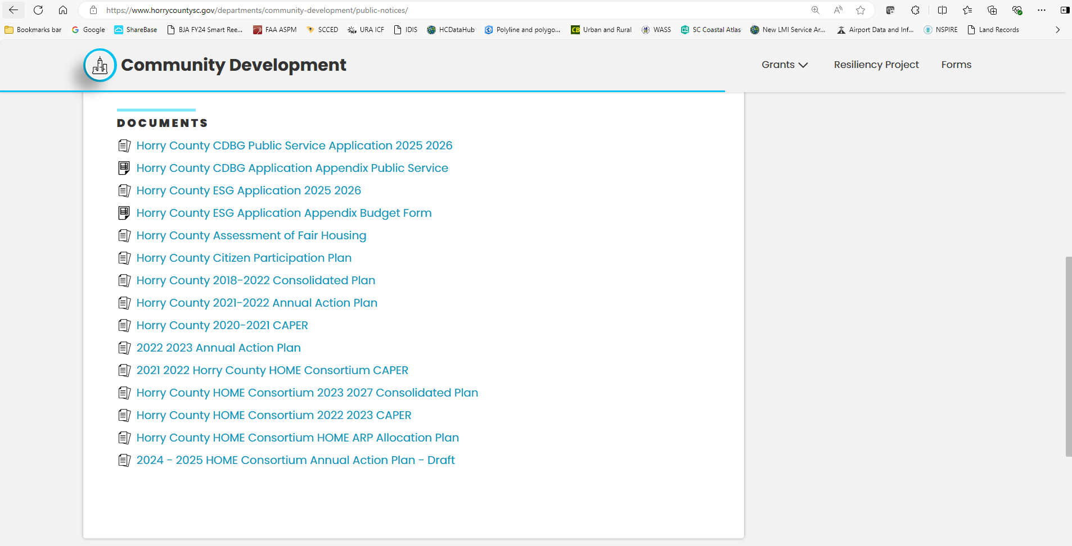
Application Locations UPDATE

Slide 29
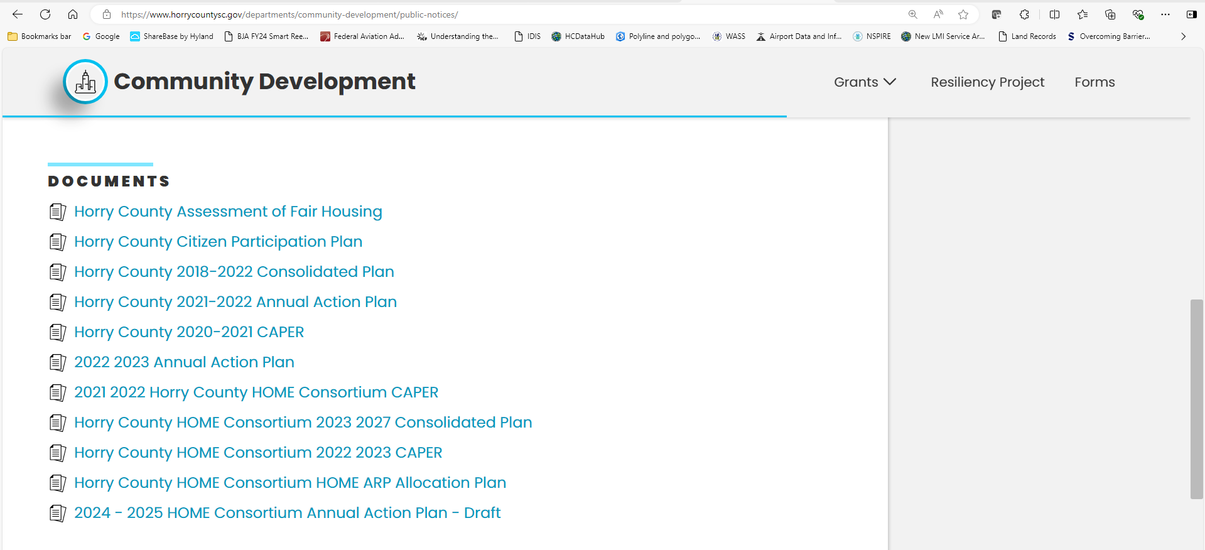
Resource Locations

Slide 30
Questions
  Please ask any application or general CDBG questions that you may have.
  Please email any CDBG project-specific questions to:
  Dobson.Michael@horrycountysc.gov

Slide 31
Contact Information
  Horry County Community Development
  100 Elm Street
  Conway, SC 29526
  (843) 915-7033
  Dobson.Michael@horrycountysc.gov (CDBG)
  Warren.Natalie@horrycountysc.gov (CDBG)
  Wiestner.Carol@horrycountysc.gov (ESG)
  Please submit questions through email so that answers can be published
  as addenda

